Slide 1
Hybrid Variation vs. Batch Variation NA
Karen Richard and Ganesh Kumar

Slide 2
Objective
Determine Genetic Variation vs. Batch Variation in corn vigor response as determined by RET2.0 in NA production data

Slide 3
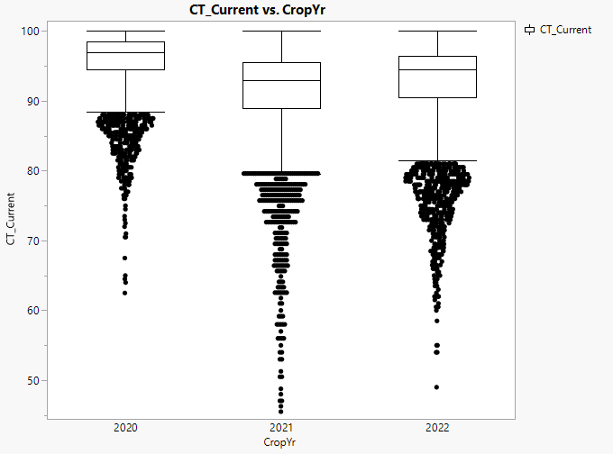
Hybrid Vigor Dataset
Records were extracted from a multi-year “Ultimate file.” Specifically, commercial finished batch records from August 2020 to August 2023 were reviewed for potential analysis.
Only new crop batches were considered for analysis to eliminate age and multi-year processing effects from impacting results.
Only batches produced at internal Bayer plants were considered for analysis
All hybrids with only one production batch were eliminated from consideration (since hybrid variation could not be determined)
RET 2.0 vigor results were used for this analysis. (Only the most recent record for a batch was considered if there were multiple records for a batch within a year).
23,236 Finished Hybrid corn batches were analyzed
Base Female and Trait data were not available for analysis
N=8,340
N=8,568
N=6,328

Slide 4
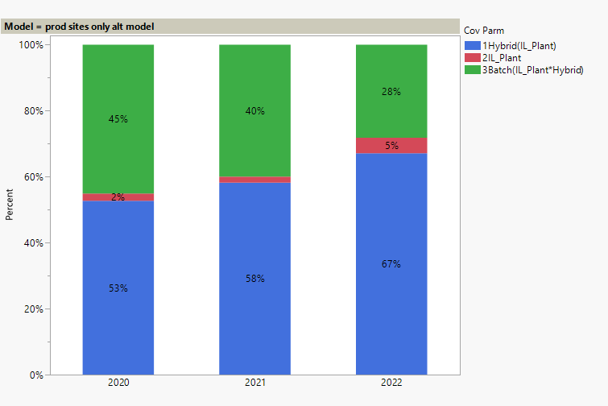
Vigor Appears to be Heritable Trait Across Years in new crop
Most Variation Due to Hybrid in Vigor Testing
Three-Level Nested Random Effects Linear Model was used to estimate the variance components to determine assignable causes for the observed variability
HPMixed, a specialized procedure in SAS software, was used to estimate the model. This procedure is specifically designed to cope with estimation problems involving large unbalanced datasets

Slide 5
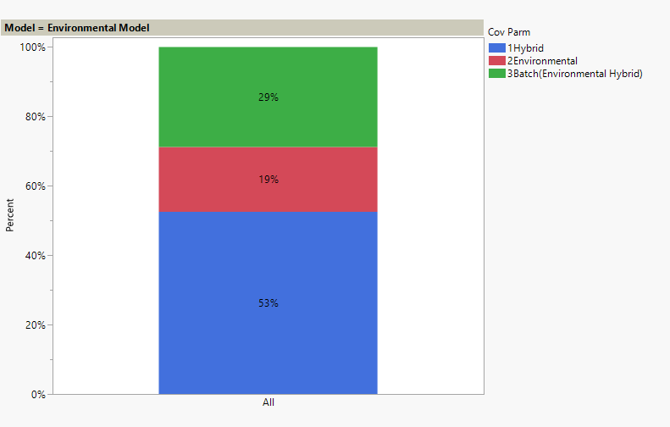
Vigor Still Appears to be Heritable Trait After Combining Years in new crop
Most Variation Due to Hybrid in Vigor Testing
Two-Way Random Effects Treatment Structure to Estimate Heritability in Vigor Testing (where concatenated year and production site were used as environmental factor)

Slide 6
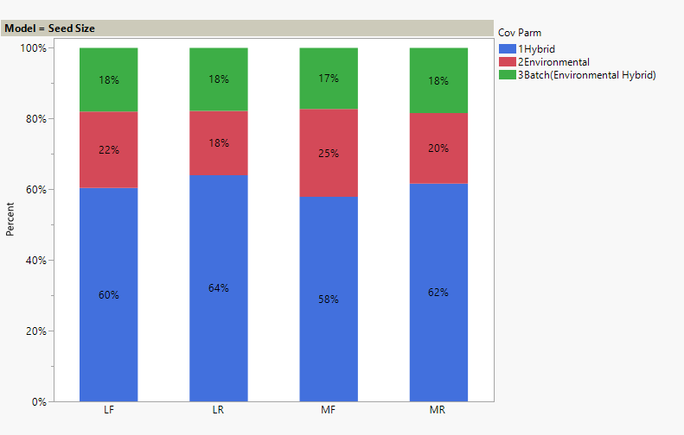
New Crop All Years by Seed Size Shows Heritable by Seed Size

Slide 7
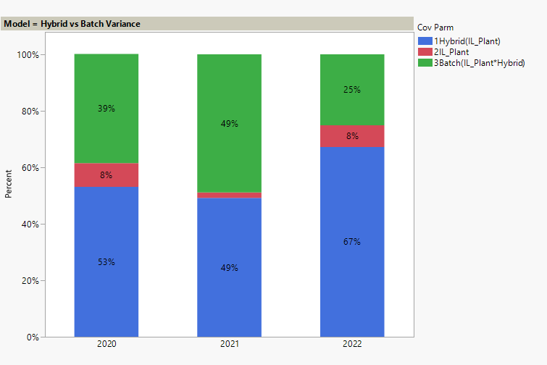
Limiting Analysis to Hybrids Produced All Three Years Shows Same Results
Only hybrids that were produced in all three years were used in this analysis
10,815 total batches
3,802 for 2020
3,046 for 2021
3,967 for 2022

Slide 8
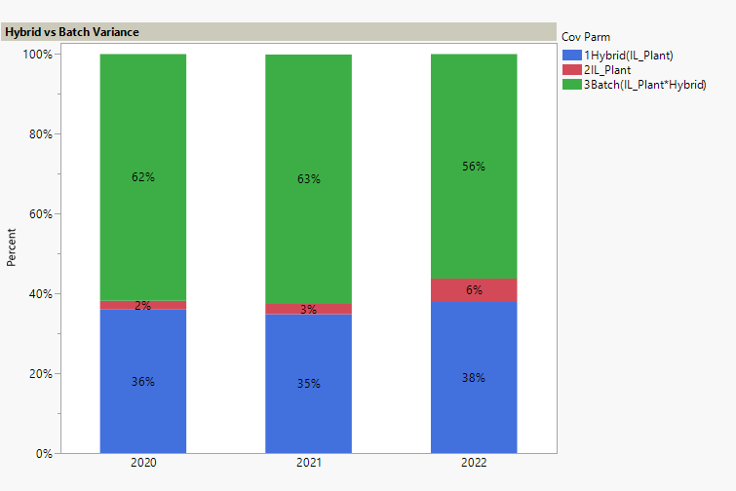
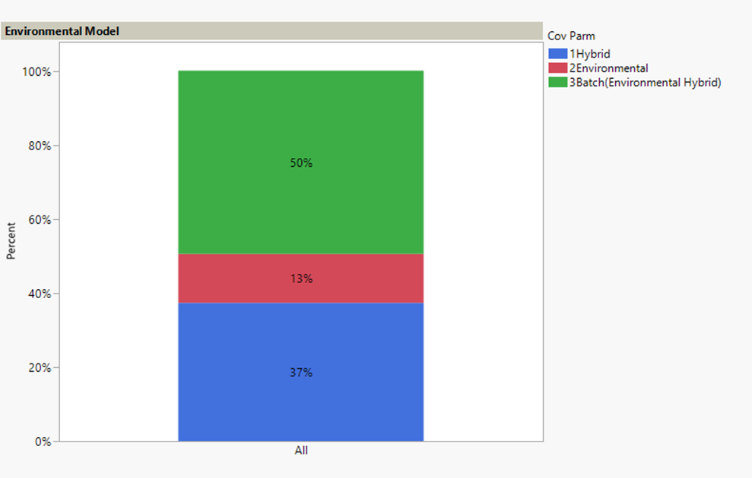
Carry-over and Re-bag Batches Show Opposite Effect
72,445 batch records were used in these analyses

Slide 9
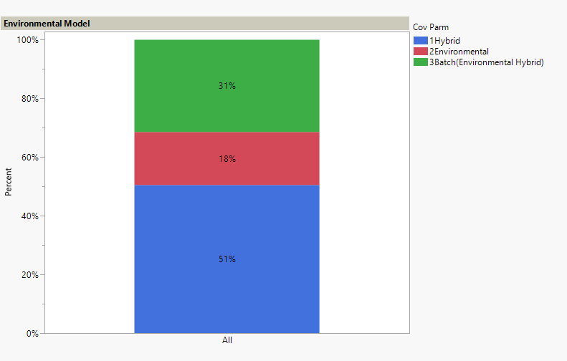
Carry-over and Rebag Batches Show Opposite Effect
Analysis was limited to those hybrids that were produced in all three years

Slide 10
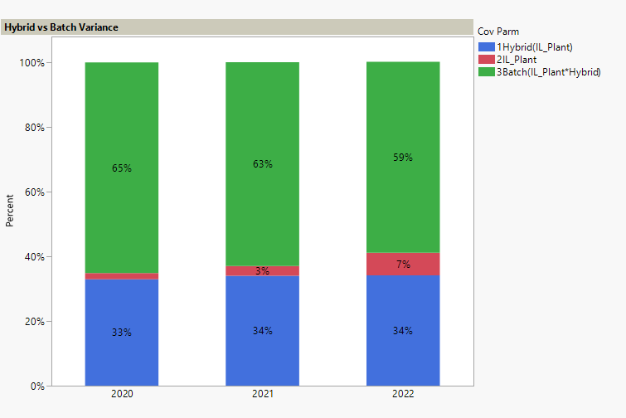
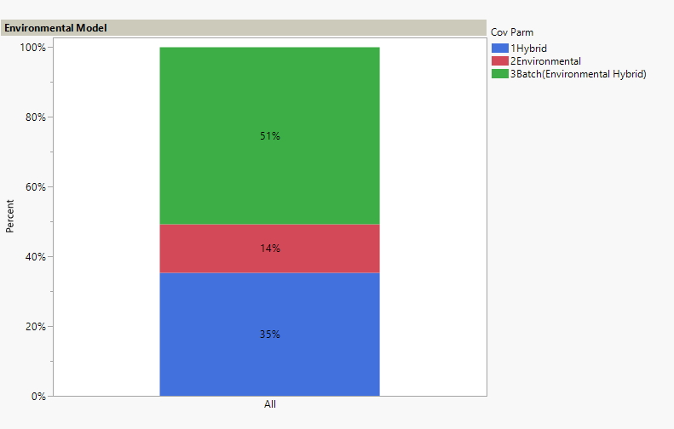
Carry-over and Rebag Batches Show Opposite Effect
Analysis was limited to those hybrids that were produced in all three years
63,200 batch records were used in these analyses

Slide 11

Limited Analysis by Seed Size Shows Results Hold

Slide 12
Summary
Commercial finished batch records from August 2020 to August 2023 were reviewed for potential analysis.
Vigor appears to be heritable trait in new crop however, the batch variation was dominated in re-bag and carryover in an across years analysis. Further, focused analysis to same hybrids produced all three years shows same trend.

Slide 13
Hybrid Variation vs. Batch Variation EMEA
Karen Richard and Ganesh Kumar

Slide 14
Objective
Determine Genetic Variation vs. Batch Variation in Vigor Testing

Slide 15
NA RET vs EMEA RET
EMEA’s vigor test is an eRET1.0 test in addition to RET1.0 test
eRET1.0 (extended RET) is a 10 day test—7 days at 13 degrees C, 3 days at 24 degrees C (RET2.0 is a 5 day test at 16 degrees C for NA)
eRET1.0 does take an image and calculate mm measurements at the end of 7 days
Both eRET1.0 scores and 5mm scores (7 day mm measurements) were analyzed separately
5mm scores performs the same as NA RET2.0 scores (i.e., Hybrid variance is higher)
eRET1.0 scores show that batch variance is higher (This probably occurs since the extra days at a warmer temperature make it perform more like a standard germination test.)

Slide 16
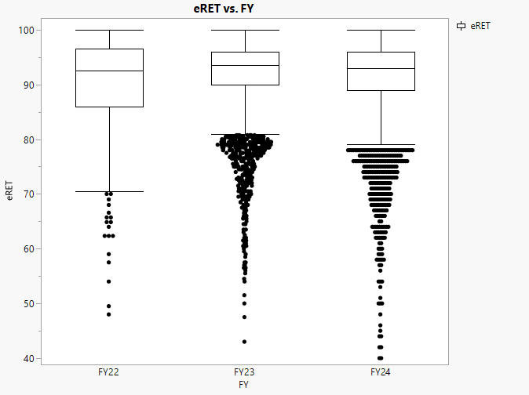
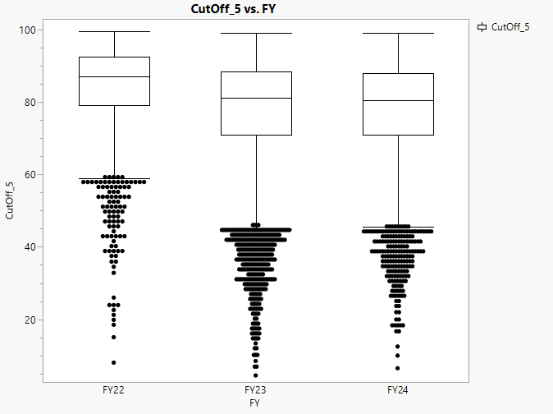
Hybrid Vigor Dataset EMEA
Records were extracted by Camille Lordon. Specifically, commercial finished batch records from FY 2022 to FY 2024 were reviewed for potential analysis.
New crop batches were considered for analysis to eliminate age and multi-year processing effects from impacting results. However, carry over/rebag were also considered in a separate analysis.
All batches were considered except those from Country=AT
All hybrids with only one production batch were eliminated from consideration (since hybrid variation could not be determined)
eRET and RET 5mm vigor results were used for this analysis. (5mm cutoff data were also used due to the high number of missing eRET.)
38,429 Finished Hybrid corn batches were analyzed
N=9,754
N=6,559
N=464
N=8,568
N=2,574
N=12,503
N=6,575

Slide 17
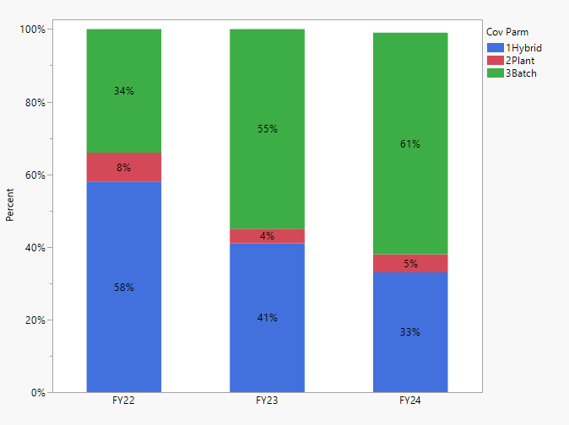
Year Dependency on Whether Vigor is a Heritable Trait for eRET1.0
Mixed results for Hybrid and Batch Variation Vigor Testing (Probably due to longer test at higher temps)
Three-Level Nested Random Effects Linear Model was used to estimate the variance components to determine assignable causes for the observed variability
HPMixed, a specialized procedure in SAS software, was used to estimate the model. This procedure is specifically designed to cope with estimation problems involving large unbalanced datasets

Slide 18
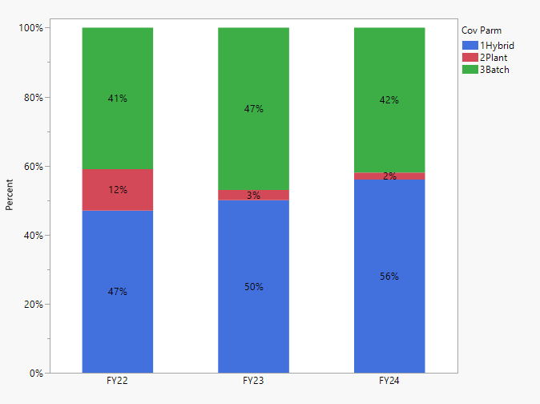
Vigor Appears to be Heritable Trait Across Years-RET1.0 5mm
Most Variation Due to Hybrid in Vigor Testing
Three-Level Nested Random Effects Linear Model was used to estimate the variance components to determine assignable causes for the observed variability
HPMixed, a specialized procedure in SAS software, was used to estimate the model. This procedure is specifically designed to cope with estimation problems involving large unbalanced datasets

Slide 19
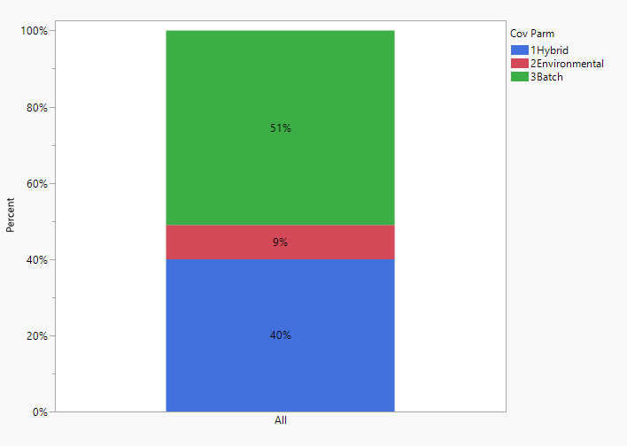
Batch Variation Still Greater After Combining Years-eRET1.0
Most Variation Due to Batch in Vigor Testing
Two-Way Random Effects Treatment Structure to Estimate Heritability in Vigor Testing (where concatenated year and production site were used as environmental factor)

Slide 20
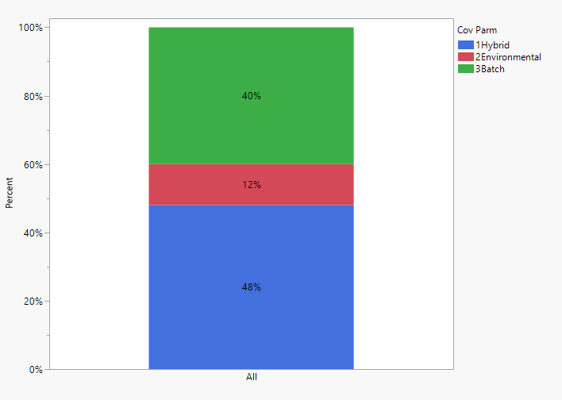
Vigor Appears to be Heritable Trait After Combining Years-RET 5mm
Most Variation Due to Hybrid in Vigor Testing
Two-Way Random Effects Treatment Structure to Estimate Heritability in Vigor Testing (where concatenated year and production site were used as environmental factor)

Slide 21
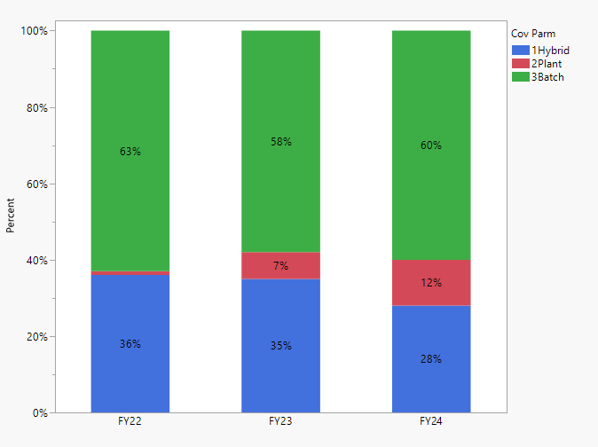
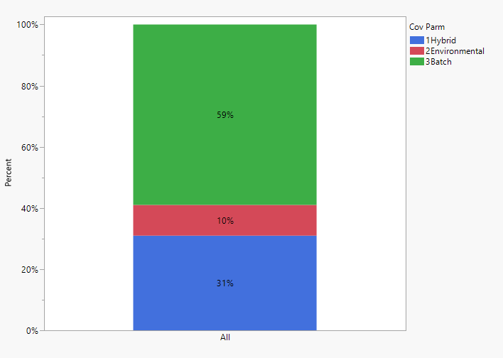
Carry-over and Rebag Batches Show Same Effect-eRET1.0
72,445 batch records were used in these analyses

Slide 22
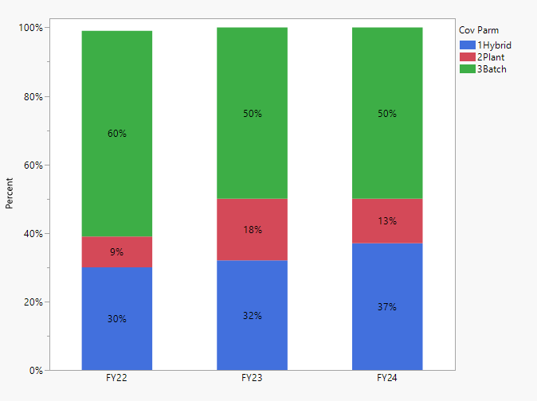
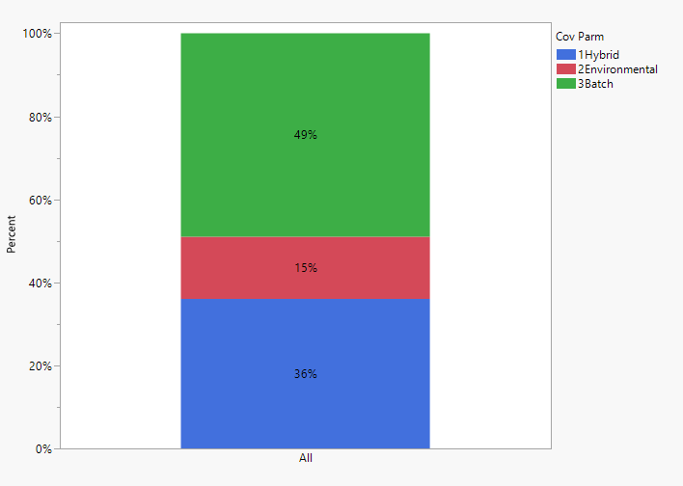
Carry-over and Rebag Batches Show Opposite Effect-RET 5mm
72,445 batch records were used in these analyses

Slide 23
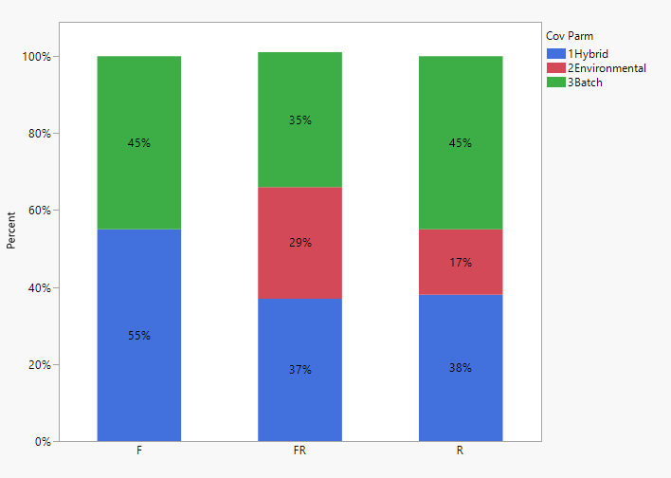
New Crop by Seed Size Shows Mixed Heritable Trait for eRET1.0

Slide 24
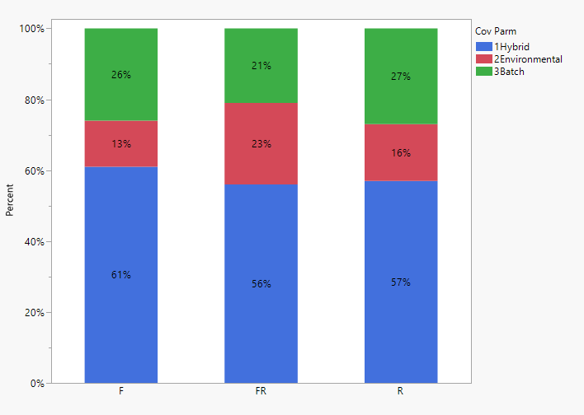
New Crop by Seed Size Shows Heritable by RET 5mm

Slide 25
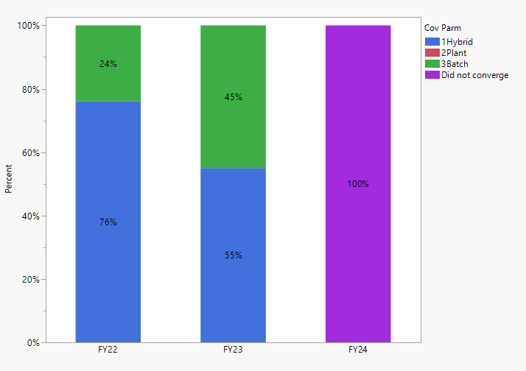
Limiting Analysis to Hybrids Produced All Three Years Shows Consistent Results for Hybrid Effect for eRET1.0
Only hybrids that were produced in all three years were used in this analysis
684 total batches
168 for 2022
491 for 2023
125 for 2024

Slide 26
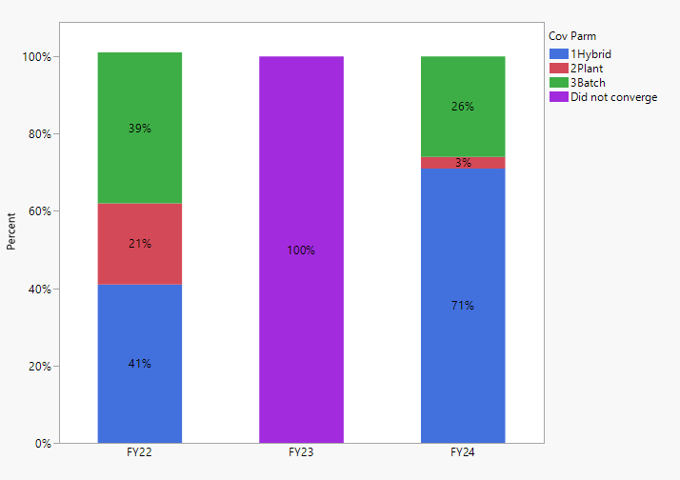
Limiting Analysis to Hybrids Produced All Three Years Shows Same Results RET 5mm
Only hybrids that were produced in all three years were used in this analysis
5,518 total batches
1,167 for 2022
3,602 for 2023
749 for 2024

Slide 27
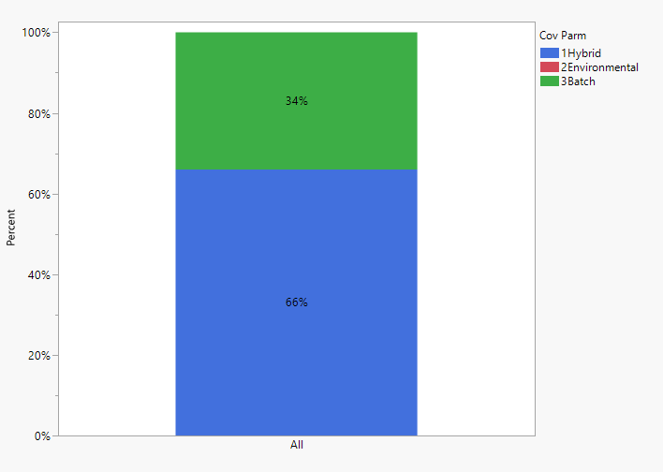
All Years Combined Show Hybrid Effect eRET1.0
Analysis was limited to those hybrids that were produced in all three years

Slide 28
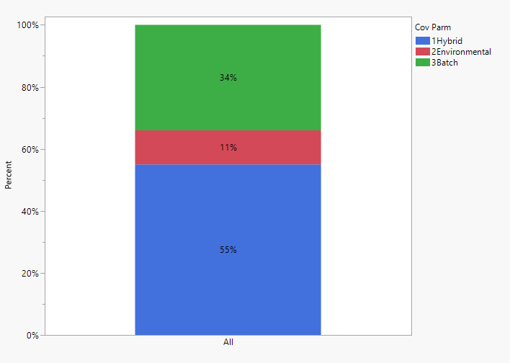
All Years Combined Show Same Effect RET 5mm
Analysis was limited to those hybrids that were produced in all three years

Slide 29
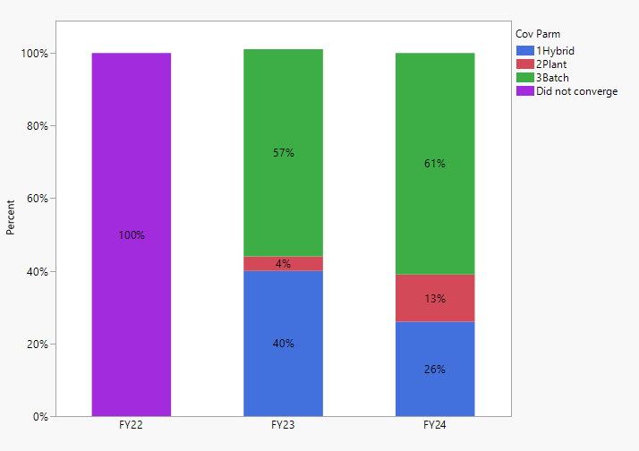
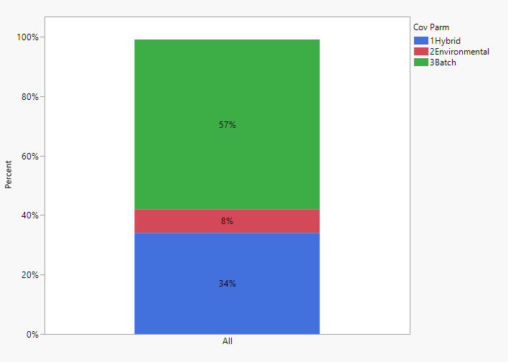
Carry-over and Rebag Batches Show Batch Effect Important eRET1.0
Analysis was limited to those hybrids that were produced in all three years
63,200 batch records were used in these analyses

Slide 30
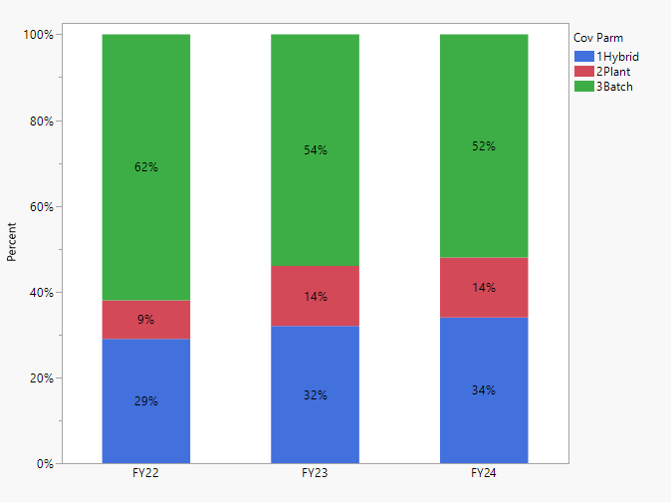

Carry-over and Rebag Batches Show Opposite Effect RET 5mm
Analysis was limited to those hybrids that were produced in all three years
63,200 batch records were used in these analyses

Slide 31
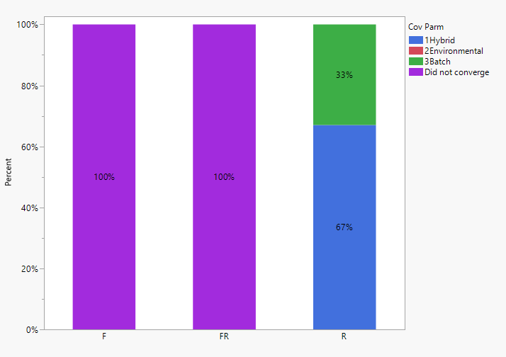
Limited Analysis by Seed Size Shows Results Hold eRET1.0

Slide 32
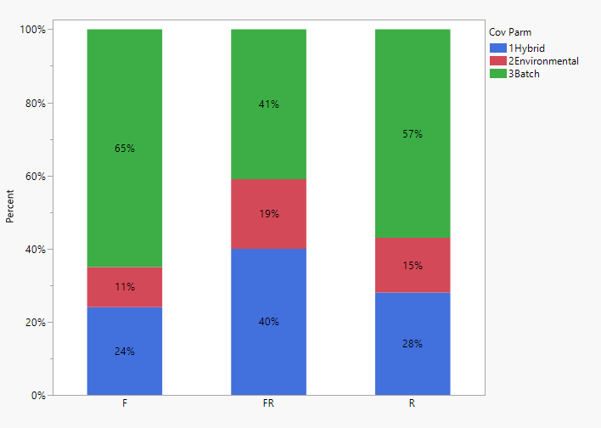
Limited Analysis by Seed Size Shows Opposite Effect RET1.0 5mm

Slide 33
Summary
Summary
Both NA and EMEA data set showed similar trend in heritability of vigor trait with RET test results. Hybrid contributed for maximum variation in vigor in the new crop. However, the batch variation was dominated in the re-bag and carryover samples in an across years analysis. Further, focused analysis in same hybrids produced all three years showed same trend.
Mixed results for hybrid and batch variation in eRET1.0, was probably because of the reduced stringency and stratification due to longer test duration and higher temps. Therefore, for heritability analysis RET test results may be more appropriate.
Follow up (Scott, Chris, Ganesh)
These results supports the need for the selection of better genetics based on base temperature approach. Follow up with Breeding to bring them up to speed on this new knowledge.
Contacts : Rebecca Thompson (Breeding); Eckhard Holzhausen (global Breeding rep for GAIN) ; Scott Johnson (PR)

Slide 34
Questions

